Slide 1
Visualizing LDDs
Jesse Stone, PDS Small Bodies Node

Slide 2
Why Visualize LDDs
LDDs can be large and difficult to navigate
This makes them more difficult to understand
It can also make it more difficult to spot errors
Generating visual representations of the LDD can make it easier to understand
These representations can also be re-used in documentation

Slide 3
IngestLDDView
A series of XSLT files that will convert an LDD to various formats
These XSLT also have accompanying scripts to perform the conversion

Slide 4
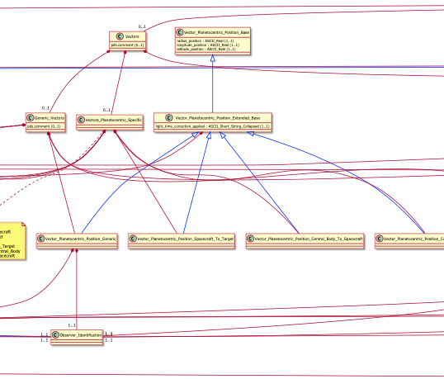
IngestLDDView - UML mode 0
Image

Slide 5
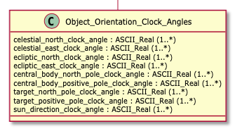
IngestLDDView - UML mode 1
Each class is drawn in a box, with the class name as a header
Attributes that belong to that class are placed lower in the box
Image

Slide 6
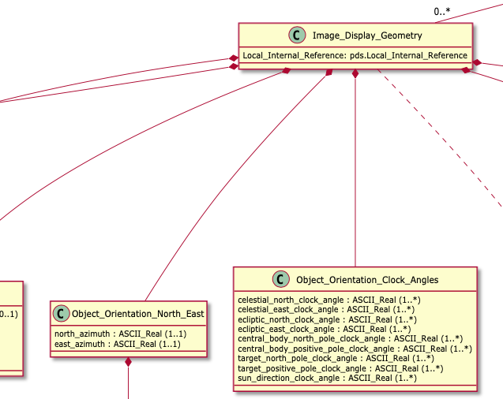
IngestLDDView - UML mode 2
Classes are connected with arrows
This illustrates how classes releate to each other
Image

Slide 7
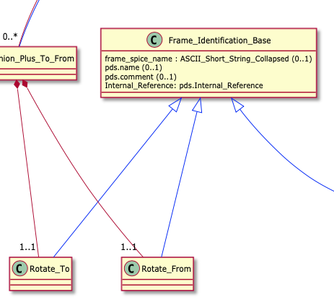
IngestLDDView - UML mode 3
Different arrows for inheritance and composition/aggregation
Image

Slide 8
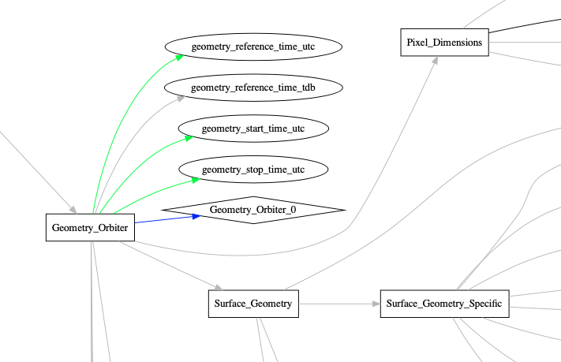
IngestLDDView - Graphviz mode 0
Image

Slide 9

IngestLDDView - Graphviz mode 1
Each class is drawn in a box
Image

Slide 10

IngestLDDView - Graphviz mode 2
Each attribute is drawn in an oval
Image

Slide 11
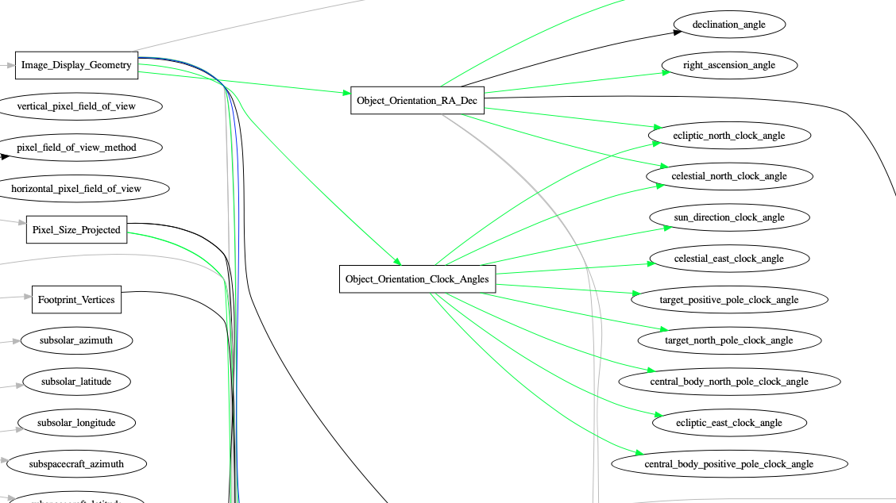
IngestLDDView - Graphviz mode 3
Classes and attributes are connectected by arrows
Unlike UML mode, This an illustrate how attributes are reused
Image

Slide 12

IngestLDDView - Graphviz mode 4
Each schematron rule is drawn in a diamond
Image

Slide 13
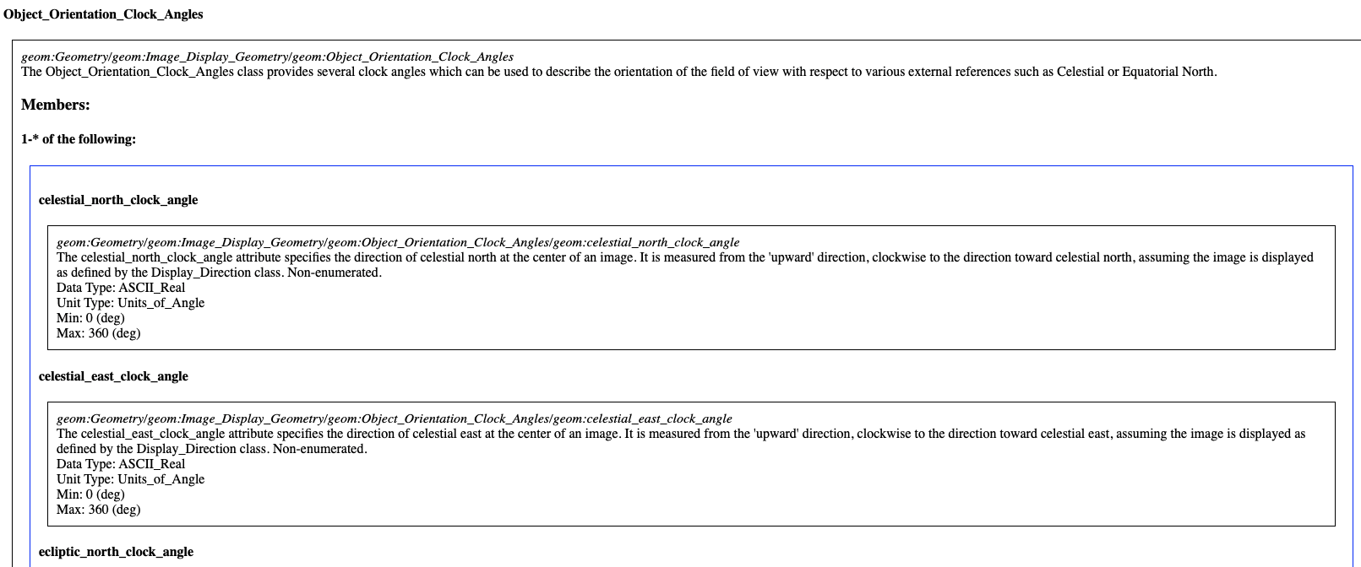
IngestLDDView - HTML Mode
Each class is described in an html fieldset
This could be used as a starting point for documetation, but it should not be the only source of documenation, since it just repeats the information in the LDD.
Image

Slide 14
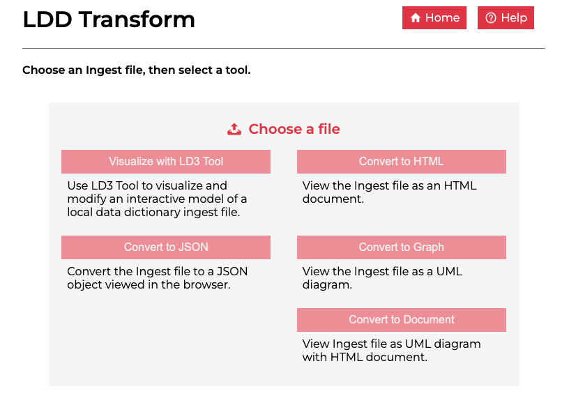
LD3 - 1
LD3 is a visualization and design tool for data dictionaries
Image

Slide 15
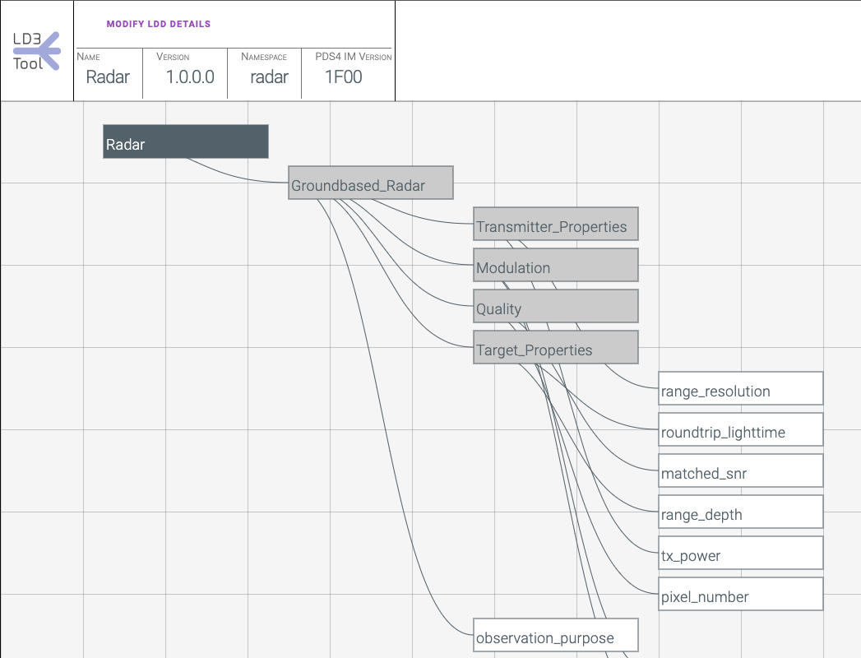
LD3 - 2
The tool is web-based, and also incorporates some of the functionality of IngestLDDView
This is just a prototype, but can be useful in some situations.
Image

